Slide 1

Introduction to Probabilistic Machine Learning
Ralf Herbrich, Rainer Schlosser
Bayesian Regression

Slide 2
Overview
Bayesian Linear Regression
Bayesian Linear Regression via Message Passing
Normal Distribution Revisited
Posterior and Predictive Distribution
Fast Bayesian Linear Regression

Slide 3
Overview
Bayesian Linear Regression
Bayesian Linear Regression via Message Passing
Normal Distribution Revisited
Posterior and Predictive Distribution
Fast Bayesian Linear Regression

Slide 4




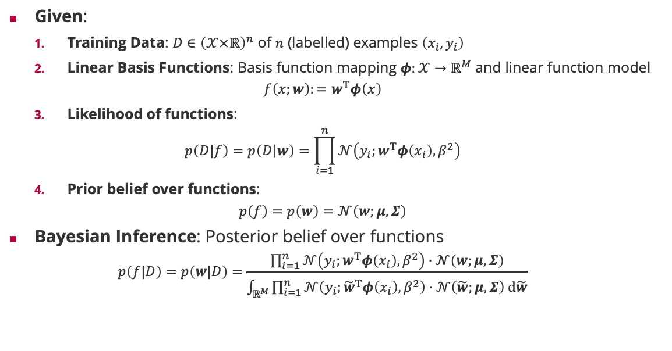






Bayesian Inference of Linear Basis Function Models
Given:
Training Data: $D∈{\left(𝒳×ℝ\right)}^{n}$ of $n$ (labelled) examples $\left(x_{i},y_{i}\right)$
Linear Basis Functions: Basis function mapping $φ:𝒳→ℝ^{M}$ and linear function model
$$f\left(x;w\right):=w^{T}φ\left(x\right)$$
Likelihood of functions:
$$p\left(D|f\right)=p\left(D | w\right)=\prod_{i=1}^{n}{𝒩\left(y_{i};w^{T}φ\left(x_{i}\right),β^{2}\right)}$$
Prior belief over functions:
$$p\left(f\right)=p\left(w\right)=𝒩\left(w;μ,Σ\right)$$
Bayesian Inference: Posterior belief over functions
$$p\left(f|D\right)=p\left(w|D\right)=\frac{\prod_{i=1}^{n}{𝒩\left(y_{i};w^{T}φ\left(x_{i}\right),β^{2}\right)}⋅𝒩\left(w;μ,Σ\right)}{\int_{ℝ^{M}}{\prod_{i=1}^{n}{𝒩\left(y_{i};{\tilde{w}}^{T}φ\left(x_{i}\right),β^{2}\right)}⋅𝒩\left(\tilde{w};μ,Σ\right) d\tilde{w}}}$$
Factor Graph
$$𝒩\left(W;μ,Σ\right)$$
$$W$$
feature vector
$$i=1,…,n$$
weight vector
Bayesian Network
$$δ\left(T_{i}−W^{T}φ\left(x_{i}\right) \right)$$
$$W$$
$$T_{i}$$
$$i=1,…,n$$
$X_{i}$
$$Y_{i}$$
$$𝒩\left(T_{i};y_{i },β^{2} \right)$$

Slide 5
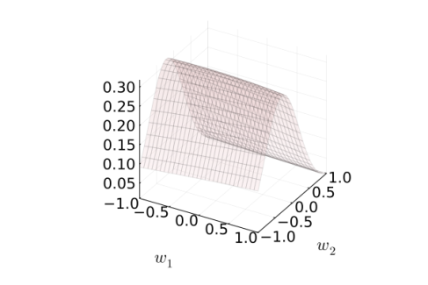
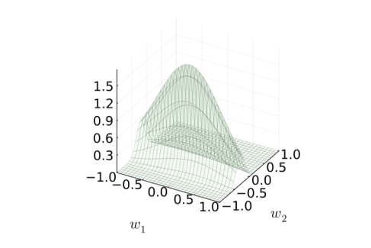
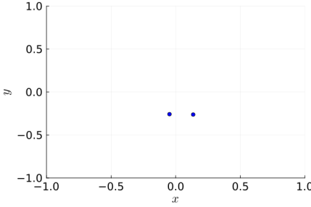
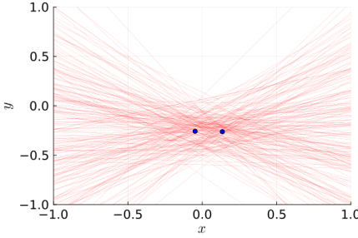
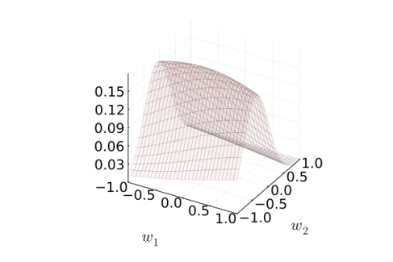
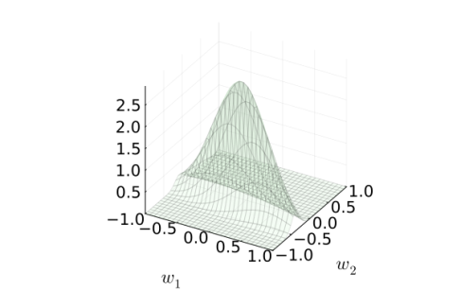
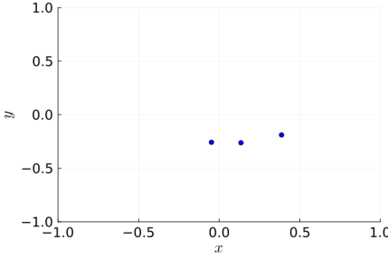
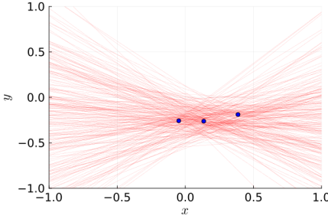
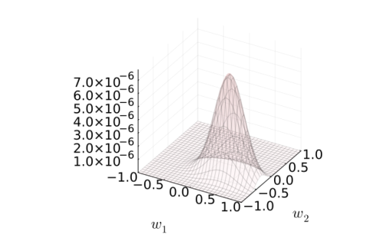
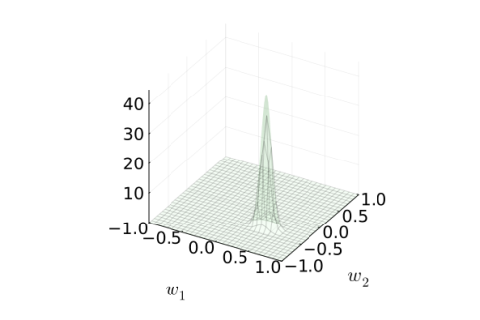
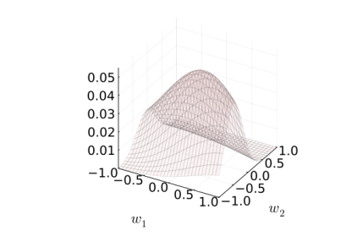
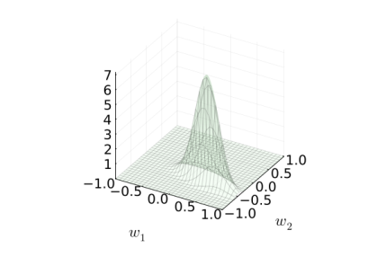
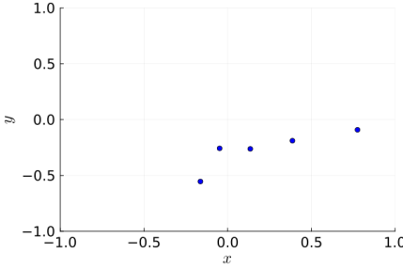
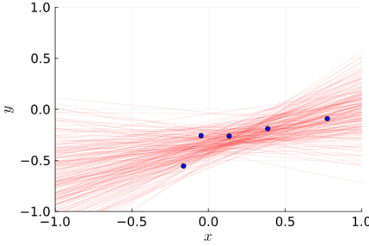
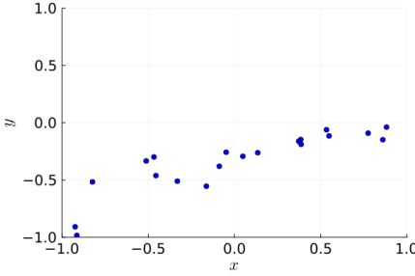
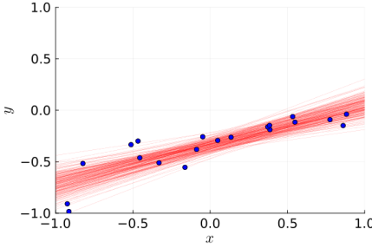







Bayesian Inference in Pictures
Likelihood
Posterior
Input Space
$$n=2$$
$$f\left(x;w\right)=w_{1}x+w_{2}$$
$$p\left(y|x;w\right)=𝒩\left(y;f\left(x\right),{0.2}^{2} \right)$$
$$p\left(w_{j}\right)=𝒩\left(w_{j};0,0.5\right)$$
$$n=3$$
$$n=5$$
$$n=20$$

Slide 6
Overview
Bayesian Linear Regression
Bayesian Linear Regression via Message Passing
Normal Distribution Revisited
Posterior and Predictive Distribution
Fast Bayesian Linear Regression

Slide 7
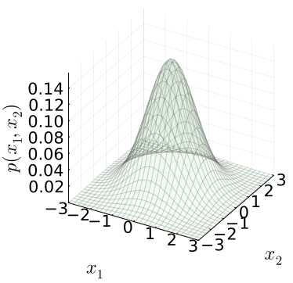
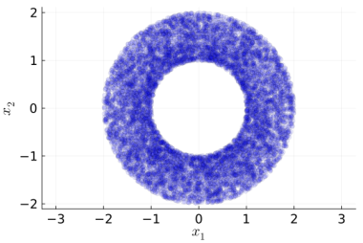
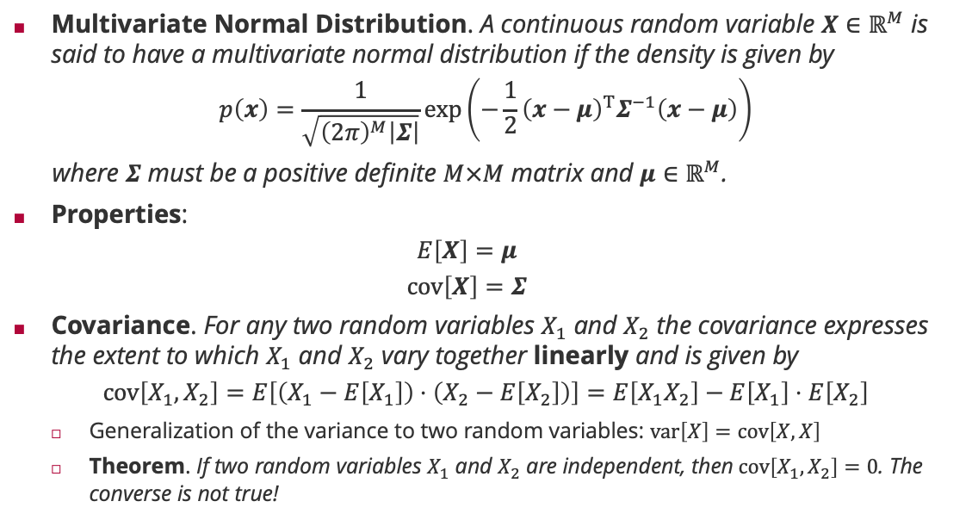
Multivariate Normal Distribution
Multivariate Normal Distribution. A continuous random variable $X∈ℝ^{M}$ is said to have a multivariate normal distribution if the density is given by
$$p\left(x\right)=\frac{1}{\sqrt{{\left(2π\right)}^{M}\left|Σ\right|}}\exp\left(−\frac{1}{2}{\left(x−μ\right)}^{T}Σ^{−1}\left(x−μ\right)\right)$$
where $Σ$ must be a positive definite $M×M$ matrix and $μ∈ℝ^{M}$.
Properties:
$$E\left[X\right]=μ$$
$$cov\left[X\right]=Σ$$
Covariance. For any two random variables $X_{1}$ and $X_{2}$ the covariance expresses the extent to which $X_{1}$ and $X_{2}$ vary together linearly and is given by
$$cov\left[X_{1},X_{2}\right]=E\left[\left(X_{1}−E\left[X_{1}\right]\right)⋅\left(X_{2}−E\left[X_{2}\right]\right)\right]=E\left[X_{1}X_{2}\right]−E\left[X_{1}\right]⋅E\left[X_{2}\right]$$
Generalization of the variance to two random variables: $var\left[X\right]=cov\left[X,X\right]$
Theorem. If two random variables $X_{1}$ and $X_{2}$ are independent, then$cov\left[X_{1},X_{2}\right]=0$. The converse is not true!

Slide 8
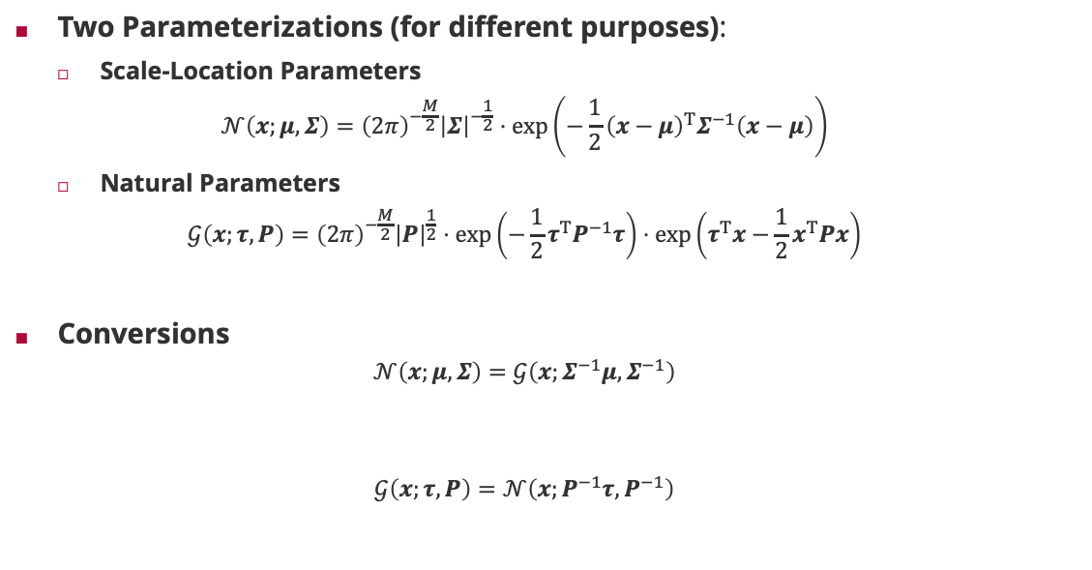
Multivariate Normal Distribution: Representations
Two Parameterizations (for different purposes):
Scale-Location Parameters
$$𝒩\left(x;μ,Σ\right)={\left(2π\right)}^{−\frac{M}{2}}{\left|Σ\right|}^{−\frac{1}{2}}⋅\exp\left(−\frac{1}{2}{\left(x−μ\right)}^{T}Σ^{−1}\left(x−μ\right)\right)$$
Natural Parameters
$$𝒢\left(x;τ,P\right)={\left(2π\right)}^{−\frac{M}{2}}{\left|P\right|}^{\frac{1}{2}}⋅\exp\left(−\frac{1}{2}τ^{T}P^{−1}τ\right)⋅\exp\left(τ^{T}x−\frac{1}{2}x^{T}Px\right)$$
Conversions
$$𝒩\left(x;μ,Σ\right)=𝒢\left(x;Σ^{−1}μ,Σ^{−1}\right)$$
$$𝒢\left(x;τ,P\right)=𝒩\left(x;P^{−1}τ,P^{−1}\right)$$
Matrix inverse

Slide 9
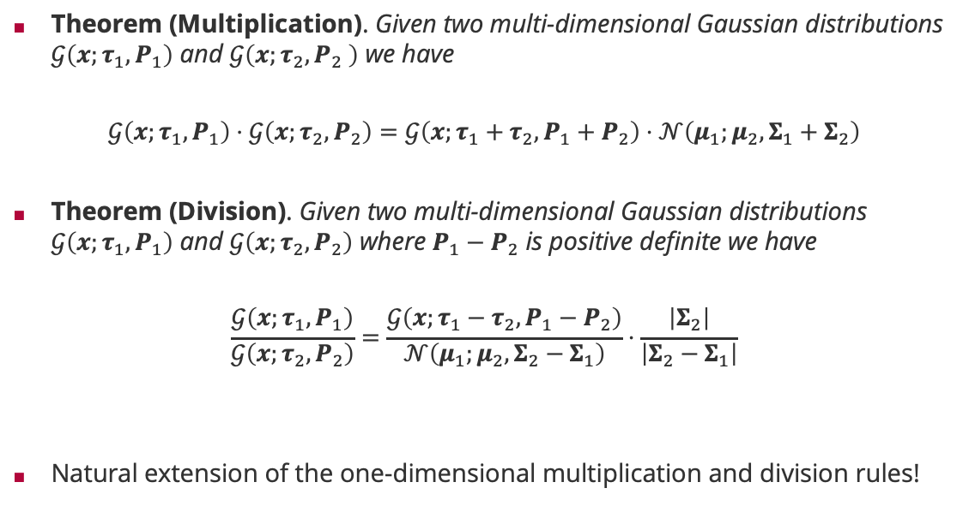
Multivariate Normal Distributions: Products & Divisions
Theorem (Multiplication). Given two multi-dimensional Gaussian distributions $𝒢\left(x;τ_{1},P_{1}\right)$ and $𝒢\left(x;τ_{2},P_{2} \right)$ we have
$$𝒢\left(x;τ_{1},P_{1}\right)⋅𝒢\left(x;τ_{2},P_{2}\right)=𝒢\left(x;τ_{1}+τ_{2},P_{1}+P_{2}\right)⋅𝒩\left(μ_{1};μ_{2}, Σ_{1}+Σ_{2}\right)$$
Theorem (Division). Given two multi-dimensional Gaussian distributions $𝒢\left(x;τ_{1},P_{1}\right)$ and $𝒢\left(x;τ_{2},P_{2}\right)$ where $P_{1}−P_{2}$ is positive definite we have
$$\frac{𝒢\left(x;τ_{1},P_{1}\right)}{𝒢\left(x;τ_{2},P_{2}\right)}=\frac{𝒢\left(x;τ_{1}−τ_{2},P_{1}−P_{2}\right)}{𝒩\left(μ_{1};μ_{2},Σ_{2}−Σ_{1}\right)}⋅\frac{\left|Σ_{2}\right|}{\left|Σ_{2}−Σ_{1}\right|}$$
Natural extension of the one-dimensional multiplication and division rules!
Gaussian density
Additive updates!
Correction factor
Subtractive updates!
Gaussian density

Slide 10
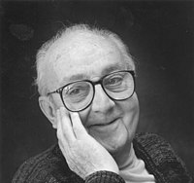

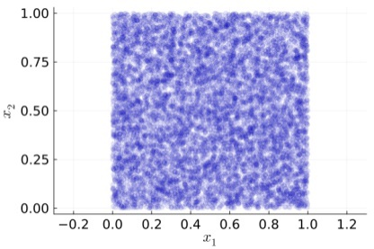
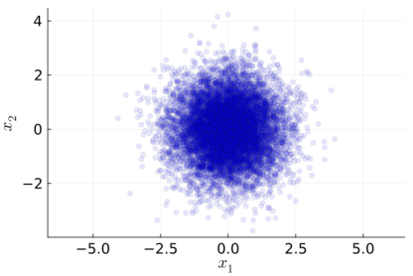
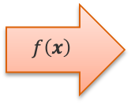
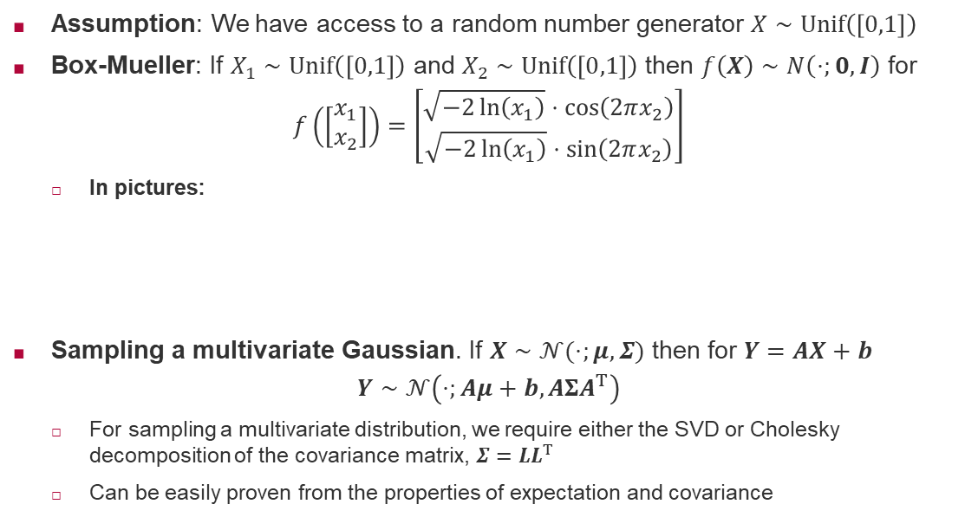
Sampling Multivariate Normal Distribution
Assumption: We have access to a random number generator $X∼Unif\left(\left[0,1\right]\right)$
Box-Mueller: If $X_{1}∼Unif\left(\left[0,1\right]\right)$ and $X_{2}∼Unif\left(\left[0,1\right]\right)$ then $f\left(X\right)∼N\left(⋅;0,I\right)$ for
$$f\left(\left[\begin{matrix}x_{1} \\ x_{2}\end{matrix}\right]\right)=\left[\begin{matrix}\sqrt{−2\ln\left(x_{1}\right)}⋅\cos\left(2πx_{2}\right) \\ \sqrt{−2\ln\left(x_{1}\right)}⋅\sin\left(2πx_{2}\right)\end{matrix}\right]$$
In pictures:
Sampling a multivariate Gaussian. If $X∼𝒩(⋅;μ,Σ)$ then for $Y=AX+b$
$$Y∼𝒩\left(⋅;Aμ+b,AΣA^{T}\right)$$
For sampling a multivariate distribution, we require either the SVD or Cholesky decomposition of the covariance matrix, $Σ=LL^{T}$
Can be easily proven from the properties of expectation and covariance
George Box (1919 – 2013)
$$f\left(x\right)$$
Mervin Mueller (1928 – 2018)

Slide 11
Overview
Bayesian Linear Regression
Bayesian Linear Regression via Message Passing
Normal Distribution Revisited
Posterior and Predictive Distribution
Fast Bayesian Linear Regression

Slide 12
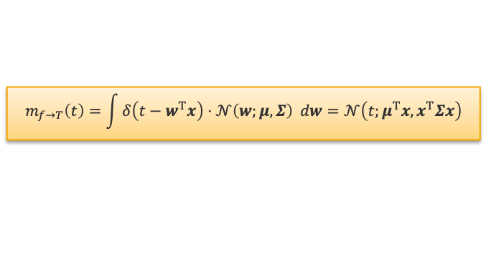
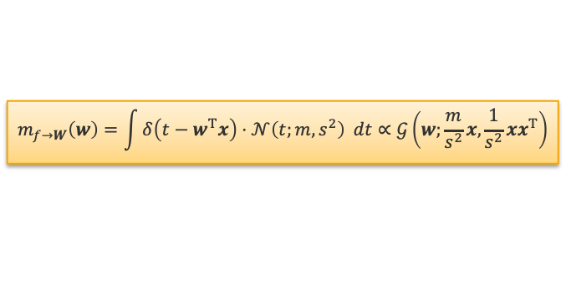



















Multivariate Message Update Equations
Gaussian Factor $𝒩\left(W;μ,Σ\right)$
Gaussian Projection Factor $δ\left({T−W}^{T}x\right)$
Factor Graph
$$m_{f→W}\left(⋅\right)$$
$$𝒩\left(⋅;μ,Σ \right)$$
$$m_{f→T}\left(⋅\right)$$
$$𝒩\left(W;μ,Σ\right)$$
$$W$$
$$W$$
$$T$$
$$W$$
$$m_{f→W}\left(w\right)=𝒩\left(w;μ,Σ\right)$$
$$m_{f→T}\left(t\right)=\int{δ\left(t−w^{T}x\right)⋅𝒩\left(w;μ,Σ\right) dw}=𝒩\left(t;μ^{T}x,x^{T}Σx\right)$$
$$i=1,…,n$$
$$δ\left(T_{i}−W^{T}φ\left(x_{i}\right) \right)$$
$$T_{i}$$
$$𝒩\left(T_{i};y_{i }β^{2} \right)$$
$$m_{f→W}\left(⋅\right)$$
$$𝒩\left(⋅;m,s^{2} \right)$$
$$W$$
$$T$$
$$m_{f→W}\left(w\right)=\int{δ\left(t−w^{T}x\right)⋅𝒩\left(t;m,s^{2}\right) dt}∝𝒢\left(w;\frac{m}{s^{2}}x,\frac{1}{s^{2}}xx^{T}\right)$$

Slide 13


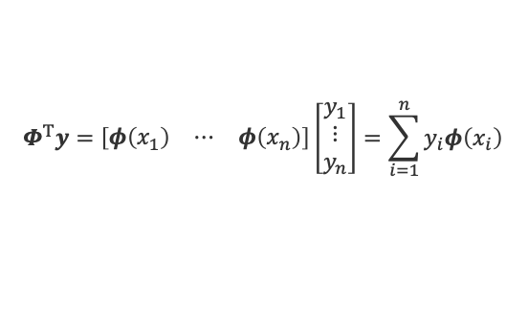






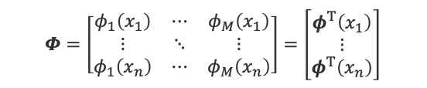





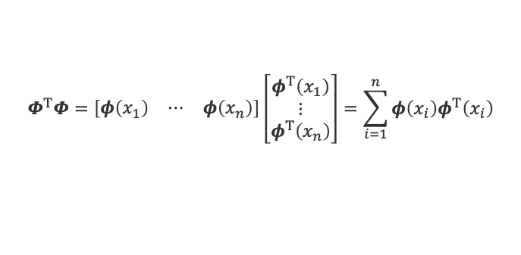



Bayesian Linear Regression by Message Passing
$$𝒩\left(W;μ,Σ\right)$$
Message: Simple factor tree where each training example is summarized in an $M$-dimensional message
Prior Message $m_{1,0}\left(w\right)=𝒢\left(w;Σ^{−1}μ,Σ^{−1}\right)=p\left(w\right)$
Target Message $m_{2,i}\left(t_{i}\right)=𝒩\left(t_{i};y_{i},β^{2}\right)=p\left(y_{i}|t_{i}\right)$
Data Message $m_{1,i}\left(w\right)=𝒢\left(w;β^{−2}y_{i}φ\left(x_{i}\right),β^{−2}φ\left(x_{i}\right)φ^{T} \left(x_{i}\right)\right)=p\left(y_{i}|w\right)$
Posterior: Multiplying prior and data messages we have
$$p\left(w|D\right)=𝒢\left(w;Σ^{−1}μ+β^{−2}\sum_{i=1}^{n}{y_{i}φ\left(x_{i}\right)},Σ^{−1}+β^{−2}\sum_{i=1}^{n}{φ\left(x_{i}\right)φ^{T} \left(x_{i}\right)}\right)$$
Feature Matrix: All feature vectors are stacked on top of each other in a feature matrix
$$m_{1,0}\left(⋅\right)$$
$$m_{1,1}\left(⋅\right)$$
$$W$$
$$m_{1,n}\left(⋅\right)$$
$$δ\left(T_{1}−W^{T}φ\left(x_{1}\right)\right)$$
$$δ\left(T_{n}−W^{T}φ\left(x_{n}\right)\right)$$
$$m_{2,1}\left(⋅\right)$$
$$m_{2,n}\left(⋅\right)$$
$$T_{1}$$
$$T_{n}$$
$$m_{2,1}\left(⋅\right)$$
$$m_{2,n}\left(⋅\right)$$
$$𝒩\left(T_{1};y_{1},β^{2}\right)$$
$$𝒩\left(T_{n};y_{n},β^{2}\right)$$
feature vector
$$Φ=\left[\begin{matrix}φ_{1}\left(x_{1}\right) & ⋯ & φ_{M}\left(x_{1}\right) \\ ⋮ & ⋱ & ⋮ \\ φ_{1}\left(x_{n}\right) & ⋯ & φ_{M}\left(x_{n}\right)\end{matrix}\right]=\left[\begin{matrix}φ^{T}\left(x_{1}\right) \\ ⋮ \\ φ^{T}\left(x_{n}\right)\end{matrix}\right]$$
$$Φ^{T}y=\left[\begin{matrix}φ\left(x_{1}\right) & ⋯ & φ\left(x_{n}\right)\end{matrix}\right]\left[\begin{matrix}y_{1} \\ ⋮ \\ y_{n}\end{matrix}\right]=\sum_{i=1}^{n}{y_{i}φ\left(x_{i}\right)}$$
$$Φ^{T}Φ=\left[\begin{matrix}φ\left(x_{1}\right) & ⋯ & φ\left(x_{n}\right)\end{matrix}\right]\left[\begin{matrix}φ^{T}\left(x_{1}\right) \\ ⋮ \\ φ^{T}\left(x_{n}\right)\end{matrix}\right]=\sum_{i=1}^{n}{φ\left(x_{i}\right)φ^{T}\left(x_{i}\right)}$$

Slide 14




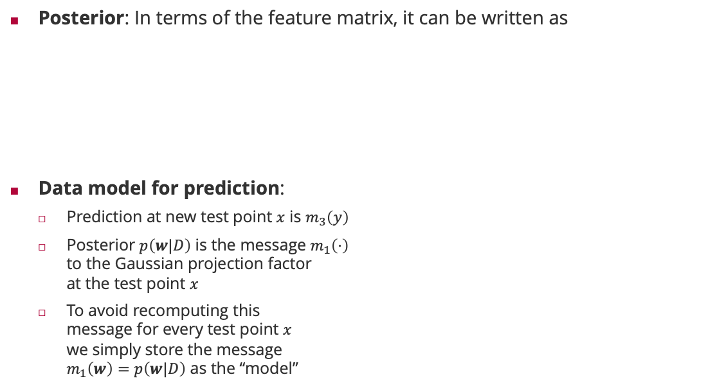























Bayesian Linear Regression: Training & Prediction
Posterior: In terms of the feature matrix, it can be written as
Data model for prediction:
Prediction at new test point $x$ is $m_{3}\left(y\right)$
Posterior $p\left(w|D\right)$ is the message $m_{1}\left(⋅\right)$ to the Gaussian projection factor at the test point $x$
To avoid recomputing this message for every test point $x$ we simply store the message $m_{1}\left(w\right)=p\left(w|D\right)$ as the “model”
$$p\left(w|D\right)=𝒢\left(w;Σ^{−1}μ+β^{−2}Φ^{T}y,Σ^{−1}+β^{−2}Φ^{T}Φ\right)$$
$$=𝒩\left(w;m, S\right)$$
$$S\left(Σ^{−1}μ+β^{−2}Φ^{T}y\right)$$
$${\left(Σ^{−1}+β^{−2}Φ^{T}Φ\right)}^{−1}$$
Posterior $p\left(w|D\right)$
$$𝒩\left(W;μ,Σ\right)$$
New test point
$$m_{1,0}\left(⋅\right)$$
$$m_{1}\left(⋅\right)$$
$$W$$
$$δ\left(T−W^{T}φ\left(x\right)\right)$$
$$m_{1,1}\left(⋅\right)$$
$$m_{1,n}\left(⋅\right)$$
$$m_{2}\left(⋅\right)$$
$$δ\left(T_{1}−W^{T}φ\left(x_{1}\right)\right)$$
$$δ\left(T_{n}−W^{T}φ\left(x_{n}\right)\right)$$
$$T$$
$$m_{2,1}\left(⋅\right)$$
$$m_{2,n}\left(⋅\right)$$
$$m_{2}\left(⋅\right)$$
$$T_{1}$$
$$T_{n}$$
$$𝒩\left(Y;T,β^{2}\right)$$
$$m_{2,1}\left(⋅\right)$$
$$m_{2,n}\left(⋅\right)$$
$$m_{3}\left(⋅\right)$$
$$Y$$
$$𝒩\left(T_{1};y_{1},β^{2}\right)$$
$$𝒩\left(T_{n};y_{n},β^{2}\right)$$

Slide 15














Predictions
Predicition Tree: Simple factor chain given posterior $p\left(w|D\right)=𝒩\left(w;m,S\right)$
Posterior Message $m_{1}\left(w\right)=𝒩\left(w;m,S\right)=p\left(w|D\right)$
Projection Message $m_{2}\left(t\right)=𝒩\left(t;m^{T}φ\left(x\right),φ^{T}\left(x\right)⋅S⋅φ\left(x\right)\right)=p\left(t|x,D\right)$
Prediction Message $m_{3}\left(y\right)=𝒩\left(y;m^{T}φ\left(x\right),β^{2}+φ^{T}\left(x\right)⋅S⋅φ\left(x\right)\right)=p\left(y|x,D\right)$
Bayesian Linear Regression in Matrix Notation
$$𝒩\left(W;m,S\right)$$
$$m_{1}\left(⋅\right)$$
$$W$$
$$m_{1}\left(⋅\right)$$
$$δ\left(T−W^{T}φ\left(x\right)\right)$$
$$m_{2}\left(⋅\right)$$
$$T$$
$$m_{2}\left(⋅\right)$$
Training
$$S={\left(Σ^{−1}+β^{−2}Φ^{T}Φ\right)}^{−1}$$
$$m=S⋅\left(Σ^{−1}μ+β^{−2}Φ^{T}y\right)$$
$$𝒩\left(Y;T,β^{2}\right)$$
$$m_{3}\left(⋅\right)$$
$$Y$$
Prediction
$$p\left(y|x,D\right)=𝒩\left(y;m^{T}φ\left(x\right),β^{2}+φ^{T}\left(x\right)⋅S⋅φ\left(x\right) \right)$$
data uncertainty
model uncertainty

Slide 16




Bayesian Linear Regression: Example
$$p\left(w\right)=𝒩\left(w;0,λ^{2}I\right)$$
$$λ=10$$
$$λ=1$$
Gaussian Basis
$$φ_{j}\left(x\right)=𝒩\left(x;j,{0.15}^{2}\right)$$
Polynomial Basis
$$φ_{j}\left(x\right)=x^{j}$$

Slide 17
Overview
Bayesian Linear Regression
Bayesian Linear Regression via Message Passing
Normal Distribution Revisited
Posterior and Predictive Distribution
Fast Bayesian Linear Regression

Slide 18



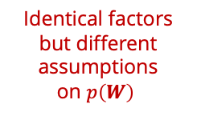

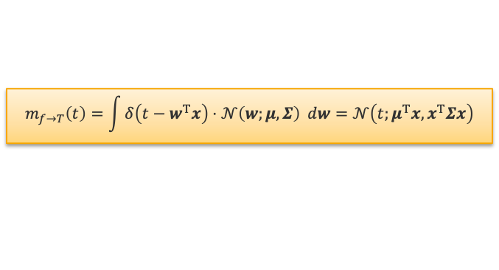










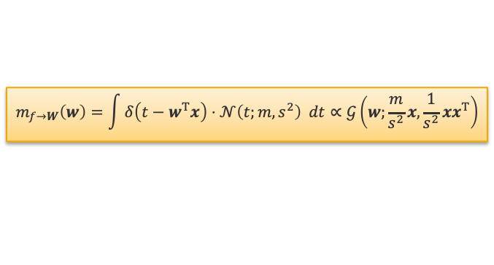





Gaussian Projection Factor Revisited
Identical factors but different assumptions on $p\left(W\right)$
Gaussian Projection Factor $δ\left({T−W}^{T}x\right)$
Weighted Sum Factor $δ\left(T−W^{T}x\right)$
$$𝒩\left(⋅;μ,Σ \right)$$
$$m_{f→T}\left(⋅\right)$$
$$W_{1}$$
$$m_{f→W_{2}}\left(⋅\right)$$
$$m_{f→W_{1}}\left(⋅\right)$$
$$W_{2}$$
$$W$$
$$T$$
$$𝒩\left(⋅;μ_{2},σ_{2}^{2}\right)$$
$$m_{f→W}\left(⋅\right)$$
$$𝒩\left(⋅;μ_{1},σ_{1}^{2}\right)$$
$$𝒩\left(⋅;m,s^{2} \right)$$
$$𝒩\left(⋅;m,s^{2}\right)$$
$$m_{f→T}\left(⋅\right)$$
$$m_{f→T}\left(t\right)=\int{δ\left(t−w^{T}x\right)⋅𝒩\left(w;μ,Σ\right) dw}=𝒩\left(t;μ^{T}x,x^{T}Σx\right)$$
$$T$$
$$m_{f→T}\left(t\right)=𝒩\left(t;x_{1}μ_{1}+x_{2}μ_{2},x_{1}^{2}σ_{1}^{2}+x_{2}^{2}σ_{2}^{2}\right)$$
$$m_{f→W}\left(w\right)=\int{δ\left(t−w^{T}x\right)⋅𝒩\left(t;m,s^{2}\right) dt}∝𝒢\left(w;\frac{m}{s^{2}}x,\frac{1}{s^{2}}xx^{T}\right)$$
$$m_{f→W_{2}}\left(w_{2}\right)=𝒩\left(w_{2};\frac{m−x_{1}μ_{1}}{x_{2}},\frac{s^{2}+x_{1}^{2}σ_{1}^{2}}{x_{2}^{2}}\right)$$
$$m_{f→W_{1}}\left(w_{1}\right)=𝒩\left(w_{1};\frac{m−x_{2}μ_{2}}{x_{1}},\frac{s^{2}+x_{2}^{2}σ_{2}^{2}}{x_{1}^{2}}\right)$$
Inverting the sum of these matrices is $𝒪\left(M^{3}\right)$
Computing the 1D-messages is $𝒪\left(M\right)$!

Slide 19





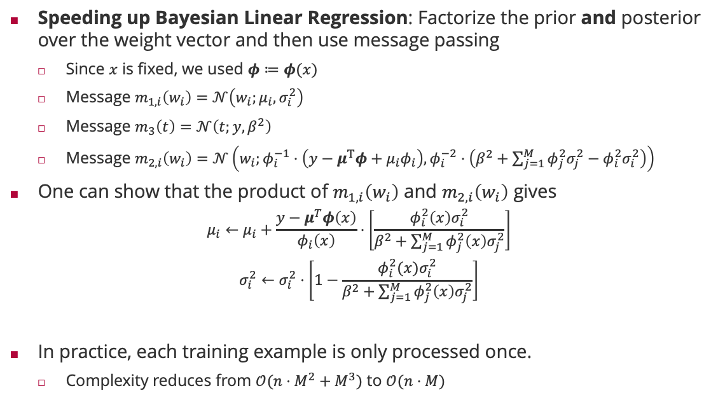








Fast Bayesian Linear Regression
$$𝒩\left(W_{1};μ_{1},σ_{1}^{2}\right)$$
$$𝒩\left(W_{M};μ_{M},σ_{M}^{2}\right)$$
Speeding up Bayesian Linear Regression: Factorize the prior and posterior over the weight vector and then use message passing
Since $x$ is fixed, we used $φ≔φ(x)$
Message $m_{1,i}\left(w_{i}\right)=𝒩\left(w_{i};μ_{i},σ_{i}^{2}\right)$
Message $m_{3}\left(t\right)=𝒩\left(t;y,β^{2}\right)$
Message $m_{2,i}\left(w_{i}\right)=𝒩\left(w_{i};φ_{i}^{−1}⋅\left(y−μ^{T}φ+μ_{i}φ_{i}\right),φ_{i}^{−2}⋅\left(β^{2}+\sum_{j=1}^{M}{φ_{j}^{2}σ_{j}^{2}}−φ_{i}^{2}σ_{i }^{2}\right)\right)$
One can show that the product of $m_{1,i}\left(w_{i}\right)$ and $m_{2,i}\left(w_{i}\right)$ gives
$$μ_{i}←μ_{i}+\frac{y−μ^{T}φ\left(x\right)}{φ_{i}\left(x\right)}⋅\left[\frac{φ_{i }^{2}\left(x\right)σ_{i}^{2}}{β^{2}+\sum_{j=1}^{M}{φ_{j}^{2}\left(x\right)σ_{j}^{2}}}\right]$$
$$σ_{i}^{2}←σ_{i}^{2}⋅\left[1−\frac{φ_{i }^{2}(x)σ_{i}^{2}}{β^{2}+\sum_{j=1}^{M}{φ_{j}^{2}\left(x\right)σ_{j}^{2}}}\right]$$
In practice, each training example is only processed once.
Complexity reduces from $𝒪(n⋅M^{2}+M^{3})$ to $𝒪(n⋅M)$
$$m_{1,1}\left(⋅\right)$$
$$m_{1,M}\left(⋅\right)$$
$$W_{1}$$
$$m_{2,i}\left(⋅\right)$$
$$W_{M}$$
$$δ\left(t−W^{T}φ\left(x\right)\right)$$
$$m_{3}\left(⋅\right)$$
$$T$$
$$m_{3}\left(⋅\right)$$
$$𝒩\left(T;y,β^{2}\right)$$
target mismatch is measured in units of $φ_{i}\left(x\right)$
largest for parameter with largest uncertainty so far
multiplicative update

Slide 20
Speeding up Bayesian Linear Regression
Nearly orthogonal features
Weakly correlated features
Strongly correlated features

Slide 21
Summary
Bayesian Linear Regression
Averaging over all functions weighting them by their posterior probability gives both a smoother mean and confidence intervals for each prediction (predictive distribution)
Message passing on the Bayesian Regression factor graph involves no loops and is exact
For linear basis function models with Normal noise, the posterior can be computed in closed form
Variance of Bayesian regression accounts for model uncertainty
Fast Bayesian Linear Regression
The Bayesian linear regression algorithm is of cubic complexity in the features and quadratic in the training set size
By factorizing both the prior and posterior distribution over the weight vector, we get a completely linear-complexity algorithm!

Slide 22
See you next week!

